Slide 1


BID N EVENT
EVENT MANAGEMENT WEBSITE
An E-Commerce platform for bidding and planning events according to customers choice

Slide 2




OUR TEAM
Shradha Saxena
Divya Singh
Front-end Developer
Back-end Developer
Swapnil Gupta
Arpita Chauhan
Front-end Developer
Back-end Developer

Slide 3

OUR MENTOR
Abhishek Tiwari
Technical Trainer
Training And Development

Slide 4

Objective
Create a unique e-commerce platform for event management allowing vendors to bid on categorized events with a spark of lightning and musical events.

Slide 5
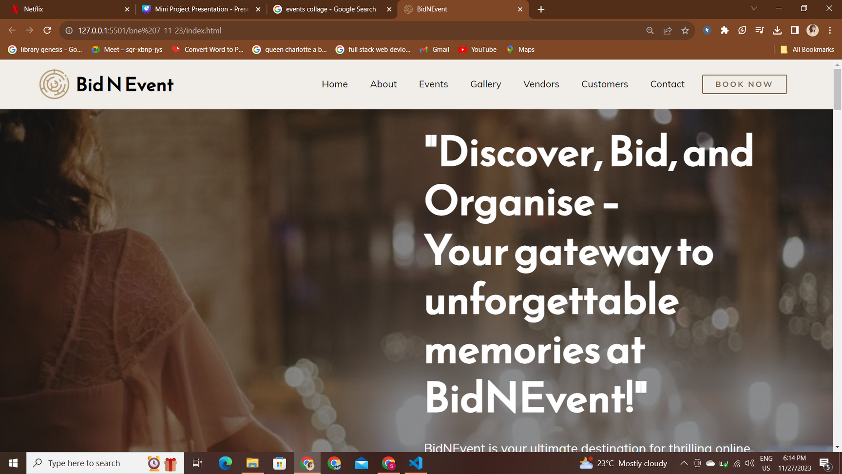
Scope
Bidnevent is a pioneering e-commerce platform designed to revolutionize the world of event management. The project's main goal is to create a unique and user-friendly platform that empowers event organizers to efficiently plan and manage events.
Bidnevent is set to bring a fresh approach to event planning by incorporating the excitement of lightning and musical events. Our project is limited to the local area people of Mathura. Our project’s scope is to help people organize events remotely.

Slide 6
Methodology:
Node JS
MongoDB
HTML & CSS
Used for connecting frontend with the database and server.
Used for storing data for all the authentic users and vendors and storing the item details for selling and bidding.
Used for the structure of the website, it gives an interface to our website
Used to define styles for the web pages, including the design, layout and variations in display for different devices and screen sizes.

Slide 7


Features

Slide 8

Intuitive User Interface
Bidnevent offers a visually appealing and easy-to-navigate interface crafted using HTML and CSS, ensuring a seamless user experience.
Event Categories
Events are systematically categorized to simplify the event selection process for users..

Slide 9
Vendor Bidding
Vendors can competitively bid on listed events, promoting fair competition and diverse services for event organizers.
Customized Packages
Bidnevent provides a platform for event organizers to create personalized event packages tailored to their specific requirements.

Slide 10
Data Management
MongoDB serves as the robust backend database, ensuring efficient storage and retrieval of event-related information.
Real-Time Interactions
Node.js powers the server-side development, enabling real-time updates and interactions between users and the platform.

Slide 11

LET’S BEGIN!

Slide 12
EXPECTED OUTCOMES
Simplify Event Planning:
Promote Creativity:
Streamline event planning processes, making it more accessible and efficient for users.
Encourage creativity and innovation in event execution by offering customized packages and a competitive marketplace for vendors.
Enhance User Experience:
Support Growth:
Provide a user-friendly interface for seamless navigation and real-time updates through Node.js.
Plan for scalability to accommodate a growing user base and a broad range of events.

Slide 13
EXPECTED OUTCOMES
Foster Transparency:
Revolutionize Event Management:
Establish a transparent marketplace for event-related services, benefiting both event organizers and vendors.
Redefine the event management landscape by offering a fresh perspective on event planning.
The ultimate outcome is to empower event organizers and vendors with a dynamic platform that simplifies event planning, enhances collaboration, and brings new and exciting events to life.

Slide 14
Conclusion:
Bidnevent is an event management platform designed to simplify event planning, foster innovation, and enhance collaboration.
● Efficient Event Planning:
Bidnevent streamlines the event planning process, making it accessible and efficient for event organizers and vendors.
● Innovation and Creativity:
The platform encourages creativity by offering customized packages and a competitive marketplace for vendors.

Slide 15
Conclusion:
Bidnevent is an event management platform designed to simplify event planning, foster innovation, and enhance collaboration.
● User-Centric Design:
Bidnevent provides a user-friendly interface with real-time updates, ensuring a seamless user experience.
● Scalability
The platform is built to support growth, accommodating a wide range of events and users.

Slide 16
Conclusion:
Bidnevent is an event management platform designed to simplify event planning, foster innovation, and enhance collaboration.
In summary, Bidnevent is poised to revolutionize event management by providing a fresh perspective on event planning, empowering users with a dynamic platform that simplifies event organization, fosters innovation, and brings unique and exciting events to life.
● Transparency:
Bidnevent establishes a transparent marketplace, benefiting both event organizers and vendors.

Slide 17

FUTURE SCOPE:
Bidding feature enhancement:
Search Filter:
Introducing Different Packages
Allowing vendors to bid on categorized events on specific budget, package type and agent brokerage
Customers can search according to their requirements. Users can sort
these specifications for events
Users can take advantage of previously introduced packages wich will allow them to select any package without making contacts multiple times and waiting for bidding responses

Slide 18
THANK YOU!

